Slide 1
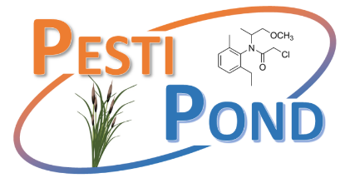




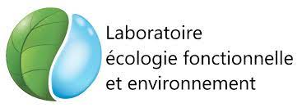

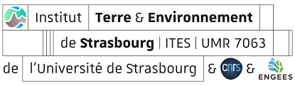

2019-2023
PESTIPOND
Role of ponds in the transfer and impact of pesticides in surface waters of the critical zone in agricultural environment
Imfeld G.¹, Payraudeau S.¹, Masbou J.¹, Drouin G.¹, Tournebize J.^{2*}, Chaumont C.², Lebrun J.², Lemaire B.², Bahi A.², Sauvage S.³, Joffre M.³, Perez Sanchez J.M.³, Chaumet B.³, Macary F⁴., Probst A.³, Probst J.L.³,
¹ UMR ITES, CNRS-ENGEES-Unistra, Strasbourg, France
² UR HYCAR, INRAE - University of Paris-Saclays, Antony, France
³ UMR LEFE, University of Toulouse, CNRS-UPS-INP, Toulouse, France
⁴ UR ETTIS, INRAE, Cestas, France

Slide 2
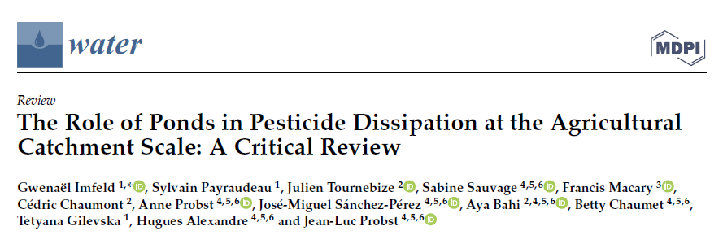
Context and objectives: give an overview of PESTIPOND results
Pesticides issue contamination
Remediation by Nature Based Solutions such as Ponds
Potential of buffer zones to mitigate pesticides pollution from agricultural areas
Field evidence of pesticide dissipation by ponds
Hierarchization of dissipation processes in different ponds’ compartments
Modelling pilot scale → full scale → upscaling: cumulative effect of ponds?
Pond is defined as any small artificial reservoir in agricultural area
Imfeld et al., 2021 doi.org/10.3390/w13091202

Slide 3
Framework of PESTIPOND Project
Imfeld et al., 2021 doi.org/10.3390/w13091202

Slide 4
Fluxes, processes and compartments

Slide 5
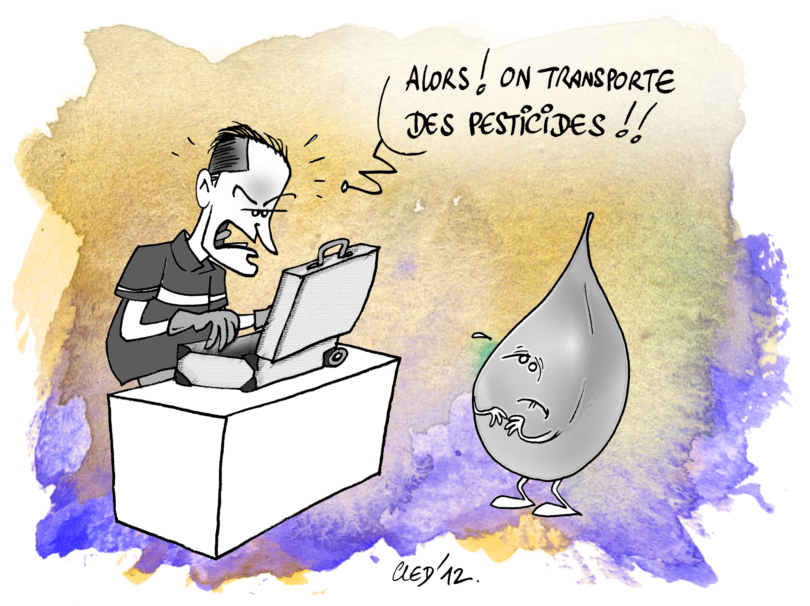
Fluxes, processes and compartments
3 complementary agricultural contexts and pond systems
27 ha
355 ha
43 ha

Slide 6
Fluxes, processes and compartments: Drainage
Artificial wetland in Rampillon: 10 years of monitoring in dissolved phase
Table of efficiency
Average 10 years: 37% of flux reduction Inlet vs Outlet

Slide 7
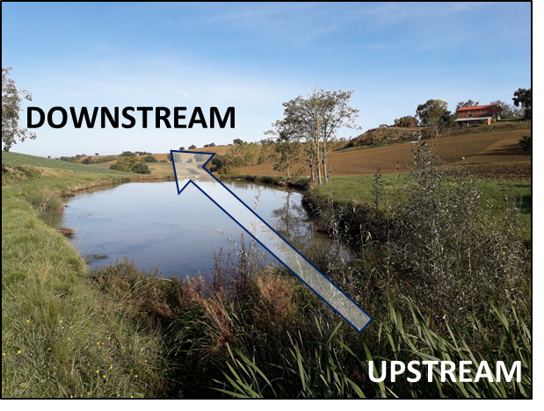

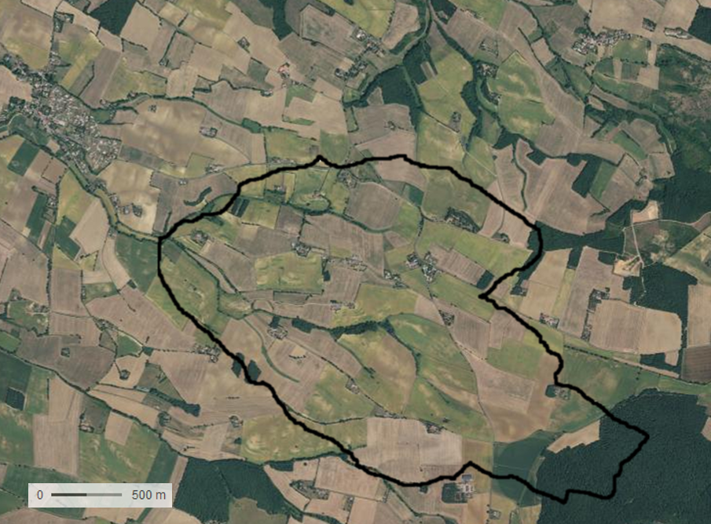
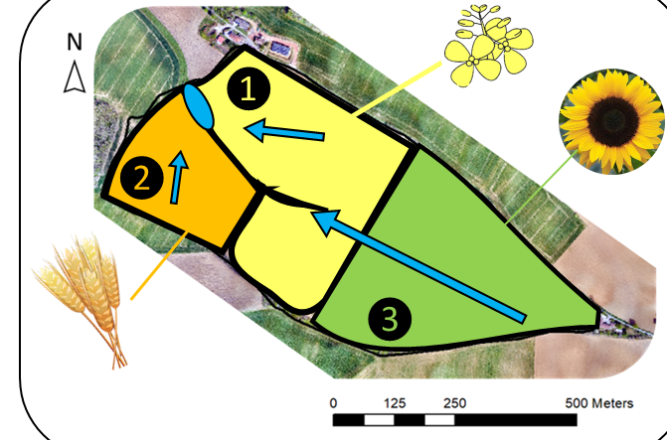
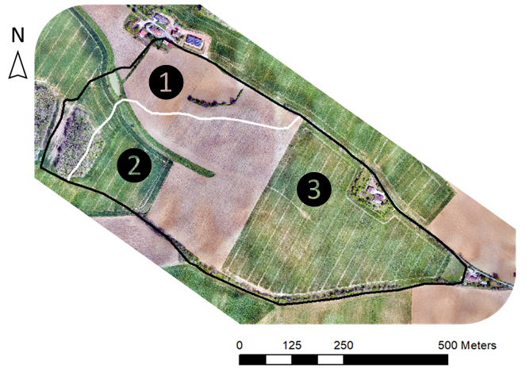
Fluxes, processes and compartments: Runoff
Study site: Auradé
Area:
Save Bassin
AURADÉ
SW France
Agricultural watershed
Steep slopes → soil erosion
Catchment: 27 ha
Pond:
N
60 m long
0
500 m
©B. Chaumet
©Google Maps
About 20 m
wide
Water column: 0.5m
Pond
Sediment layer depth: 3 m
Flow direction
Land cover:
Chaumet et al. 2021, Water https://doi.org/10.3390/w13131734
Yearly rotation
Wheat, rapeseed, sunflower
Surface sub-catchment: 27 ha

Slide 8
Fluxes, processes and compartments: Runoff
Role of the pond in dissolved and particulate
metolachlor
In: 0.5 g
Out: 0.3 g
Removal = 0.2 g
boscalid
In: 10.2 g
Out: 8.0 g
Removal = 2.2 g
epoxyconazole
In: 2.6 g
Out: 1.9 g
Removal = 0.8 g
tebuconazole
In: 12.4 g
Out: 6.9 g
Removal = 5.5 g
aclonifen
In: 0.6 g
Out: 0.3 g
Removal = 0.3 g
pendimethaline
In: 1.1 g
Out: 1.0 g
Removal = 0.1 g
Removal: 10g/year
The pond mitigated between
29 and 56%
of the six targeted pesticide molecules.
In sediment and particulate phase
Chaumet et al., 2022, JEM
doi.org/10.1016/j.jenvman.2022.115911

Slide 9
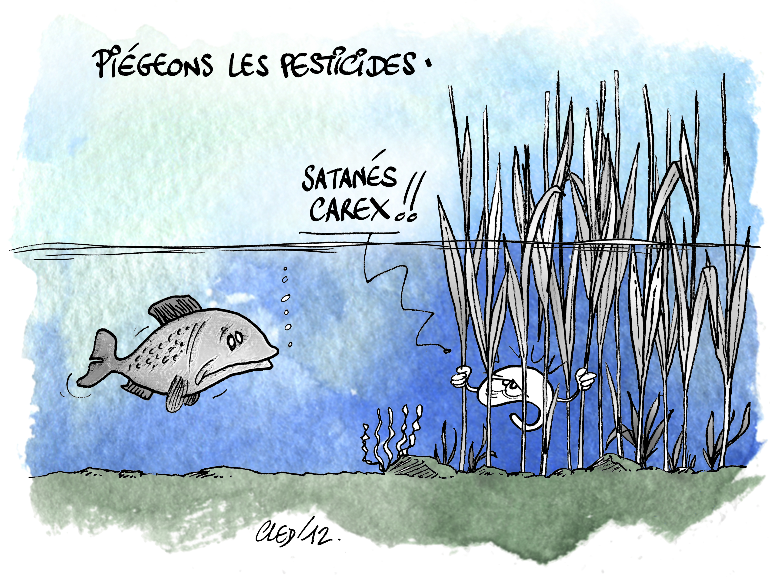
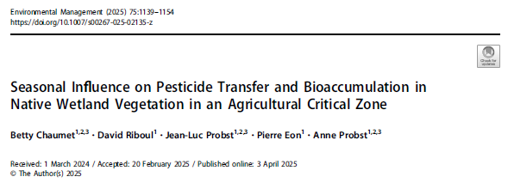
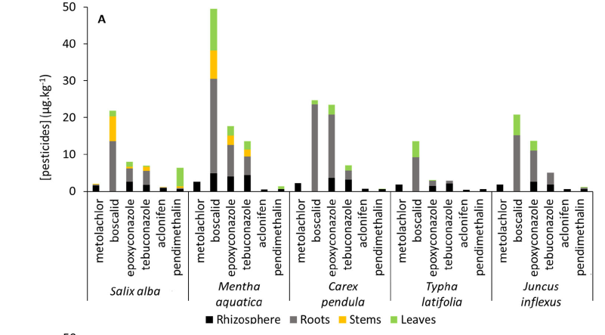
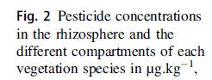
Vegetation compartment
Stock végétation <10µg (<0.1% de la dissipation)

Slide 10
Framework of PESTIPOND Project
Imfeld et al., 2021 doi.org/10.3390/w13091202

Slide 11
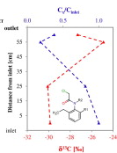
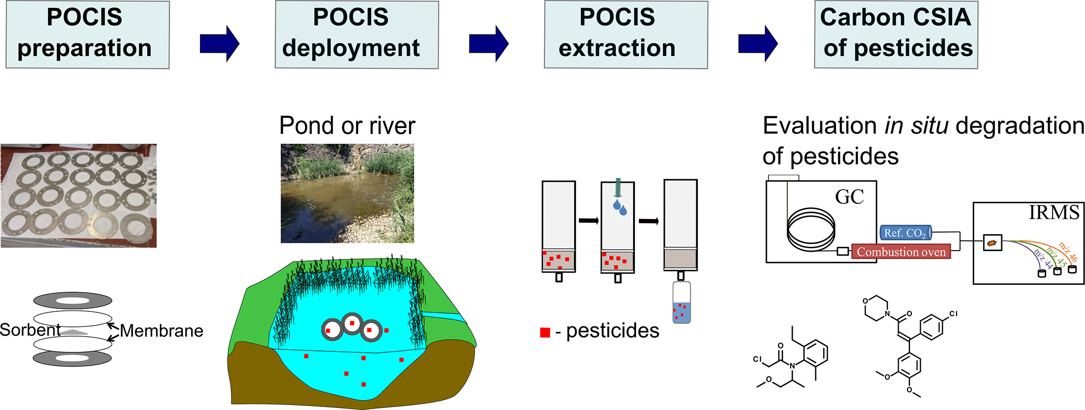
Innovative tools to evaluate pesticides dissipation
Prove natural attenuation: degradation in wetland versus dilution/export/remobilisation
Identify reaction pathways: transformation products degrade/often unknown
Reduce uncertainties: risk assessment and exposure levels
Gilevska et al., 2022 dx.doi.org/10.1016/j.scitotenv.2022.156735

Slide 12
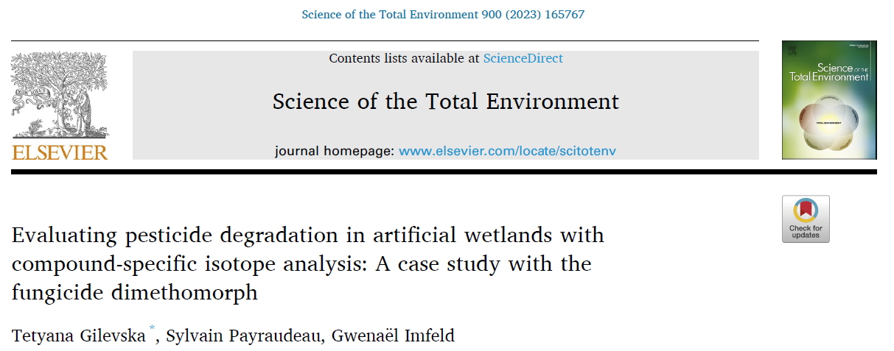
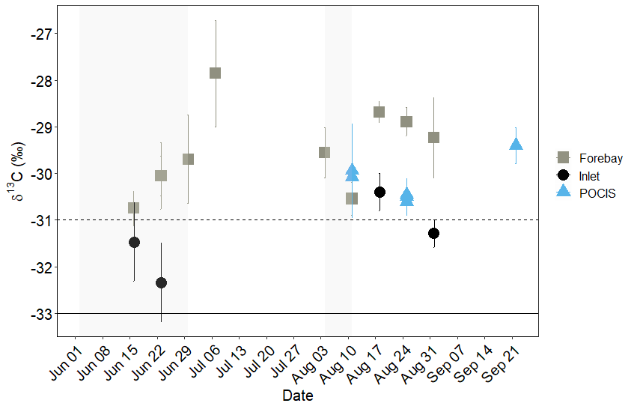
Innovative tools to evaluate pesticides dissipation :
Dimethomorph degradation
INLET
OUTLET
In situ degradation: in wetland anoxic sediment
Degraded DIM extent: 40 – 70 % across the season
DIM degradation to demethylated products (detected)
Firmicutes phylum in the sediment (« O-demethylaters »)
CSIA suggests C-O bond cleavage of DIM:
DEGRADATION
δ¹³C [‰]
DIM commercial formulation
(Griptop, BASF)
Time
Gilevska et al., 2023, Stoten
Notes:
Dimethormorph was evaluated at the inlet and outlet of the stormwater wetland receiving DIM from the vineyard catchment
Our results showed that the carbon isotopic composition of DIM Z in the wetland water (at the outlet) changed significantly (Δ13C > 3 ‰) compared to that in the runoff entering the wetland and in the commercial formulation used in the vineyard, indicating DIM degradation.
Biomolecular analysis showed that the Firmicutes phylum dominated in the sediment. Firmicutes bacteria are well-known « O-demethylaters »
The mass balance based on stable isotope data and the classical inlet-outlet mass balance aligned on dimethomorph (DIM) degradation.
Both investigation of transformation products and compound-specific isotope analysis supported the occurrence oof demethylation of ethyl ethers (O-Demethylation) as the prevailing DIM transformation pathway.
Our study indicates that CSIA is a powerful tool for evaluating in-situ pesticide degradation in wetland systems
CSIA of pesticide in wetland may provide more reliable and less cost and work-intensive estimates of the overall pesticide dissipation compared to the traditional mass balance approach

Slide 13
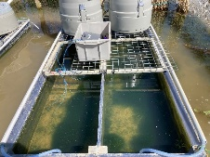
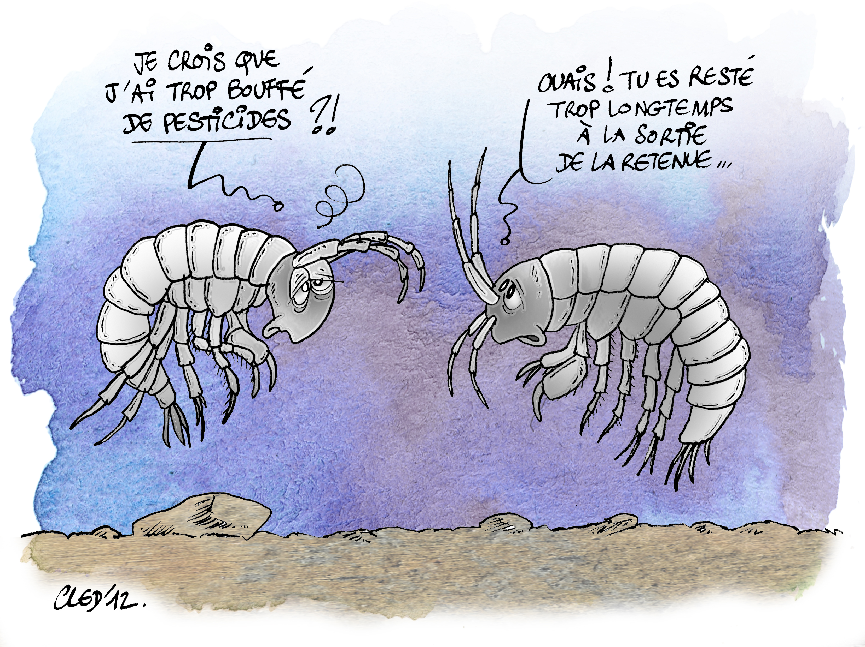
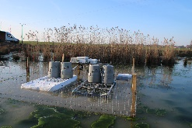
Innovative tools to evaluate pesticides dissipation
IN SITU MESOCOSM
11 pesticides applied and
monitored daily during 27 days
DT50 (Mesocosm)<< DT50 (PPDB) → Potential of wetland
Degradation: Not evidence of mineralization → Metabolites?
Storage in sediment
Relation DT50 mesocoms vs
DT50 Water/Sediment PPDB

Slide 14
Framework of PESTIPOND Project
Imfeld et al., 2021 doi.org/10.3390/w13091202

Slide 15
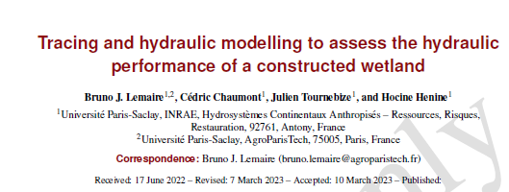
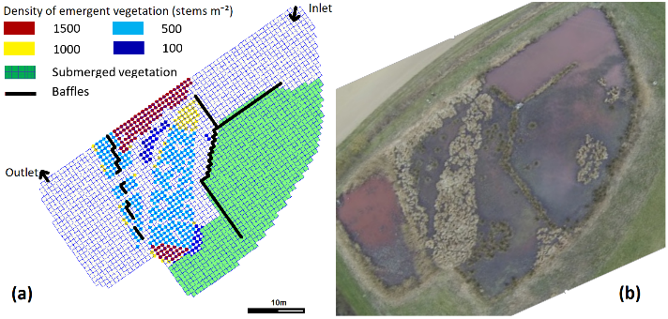
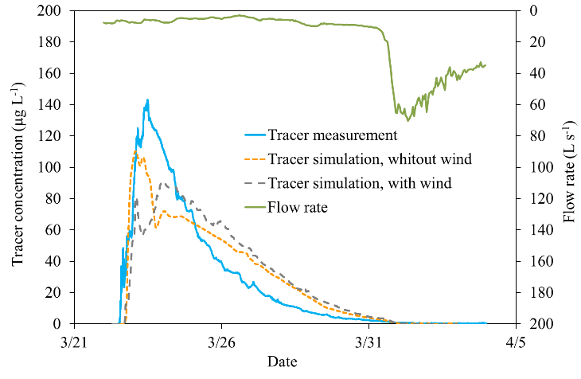
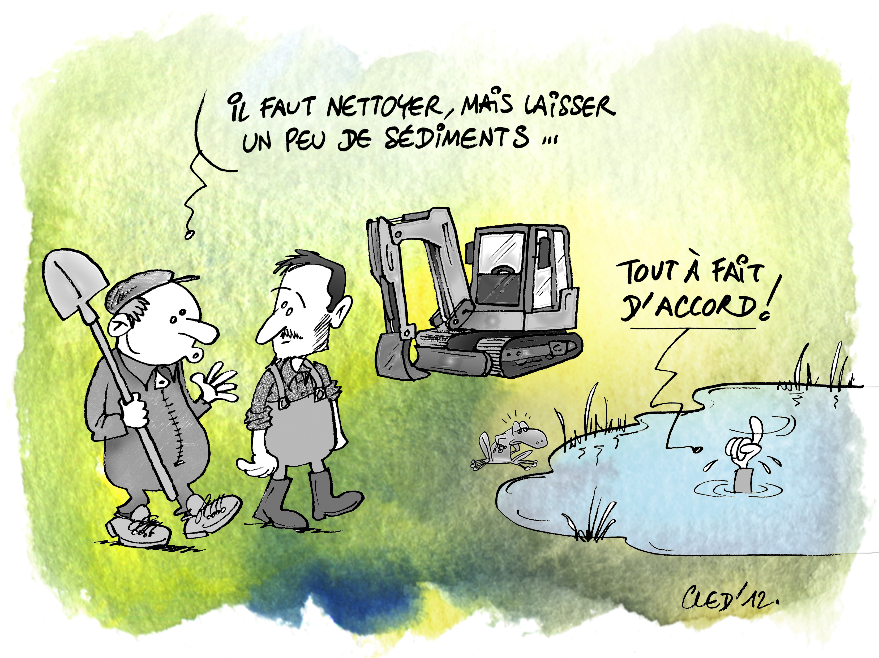
Modelling framework: 2D Physically based distributed model
Tracer modelling using DELFT3D
Integration of baffles and vegetation patches
Proceeding AISH conference 2022, published in 2024

Slide 16
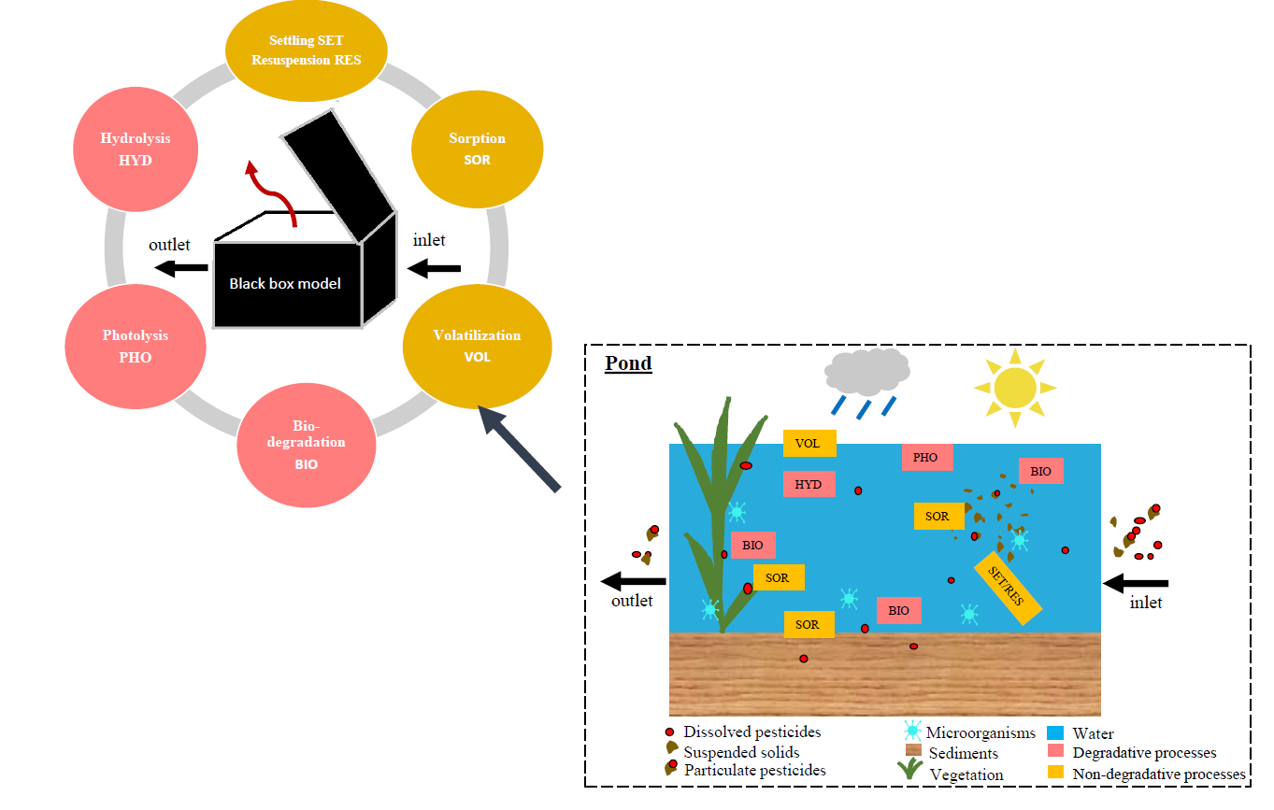
0D lumped conceptual model: Modelling framework
Review of concepts
Mathematical formulations
Bahi et al., 2023
doi.org/10.1016/j.ecoleng.2022.106820

Slide 17
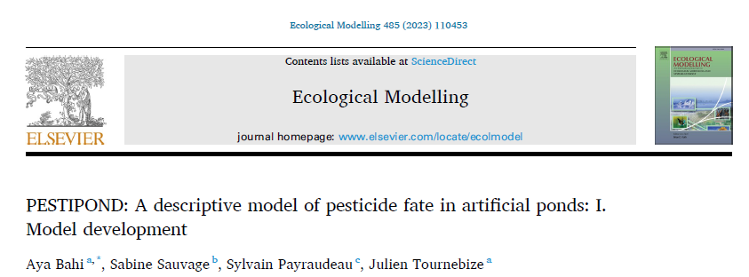
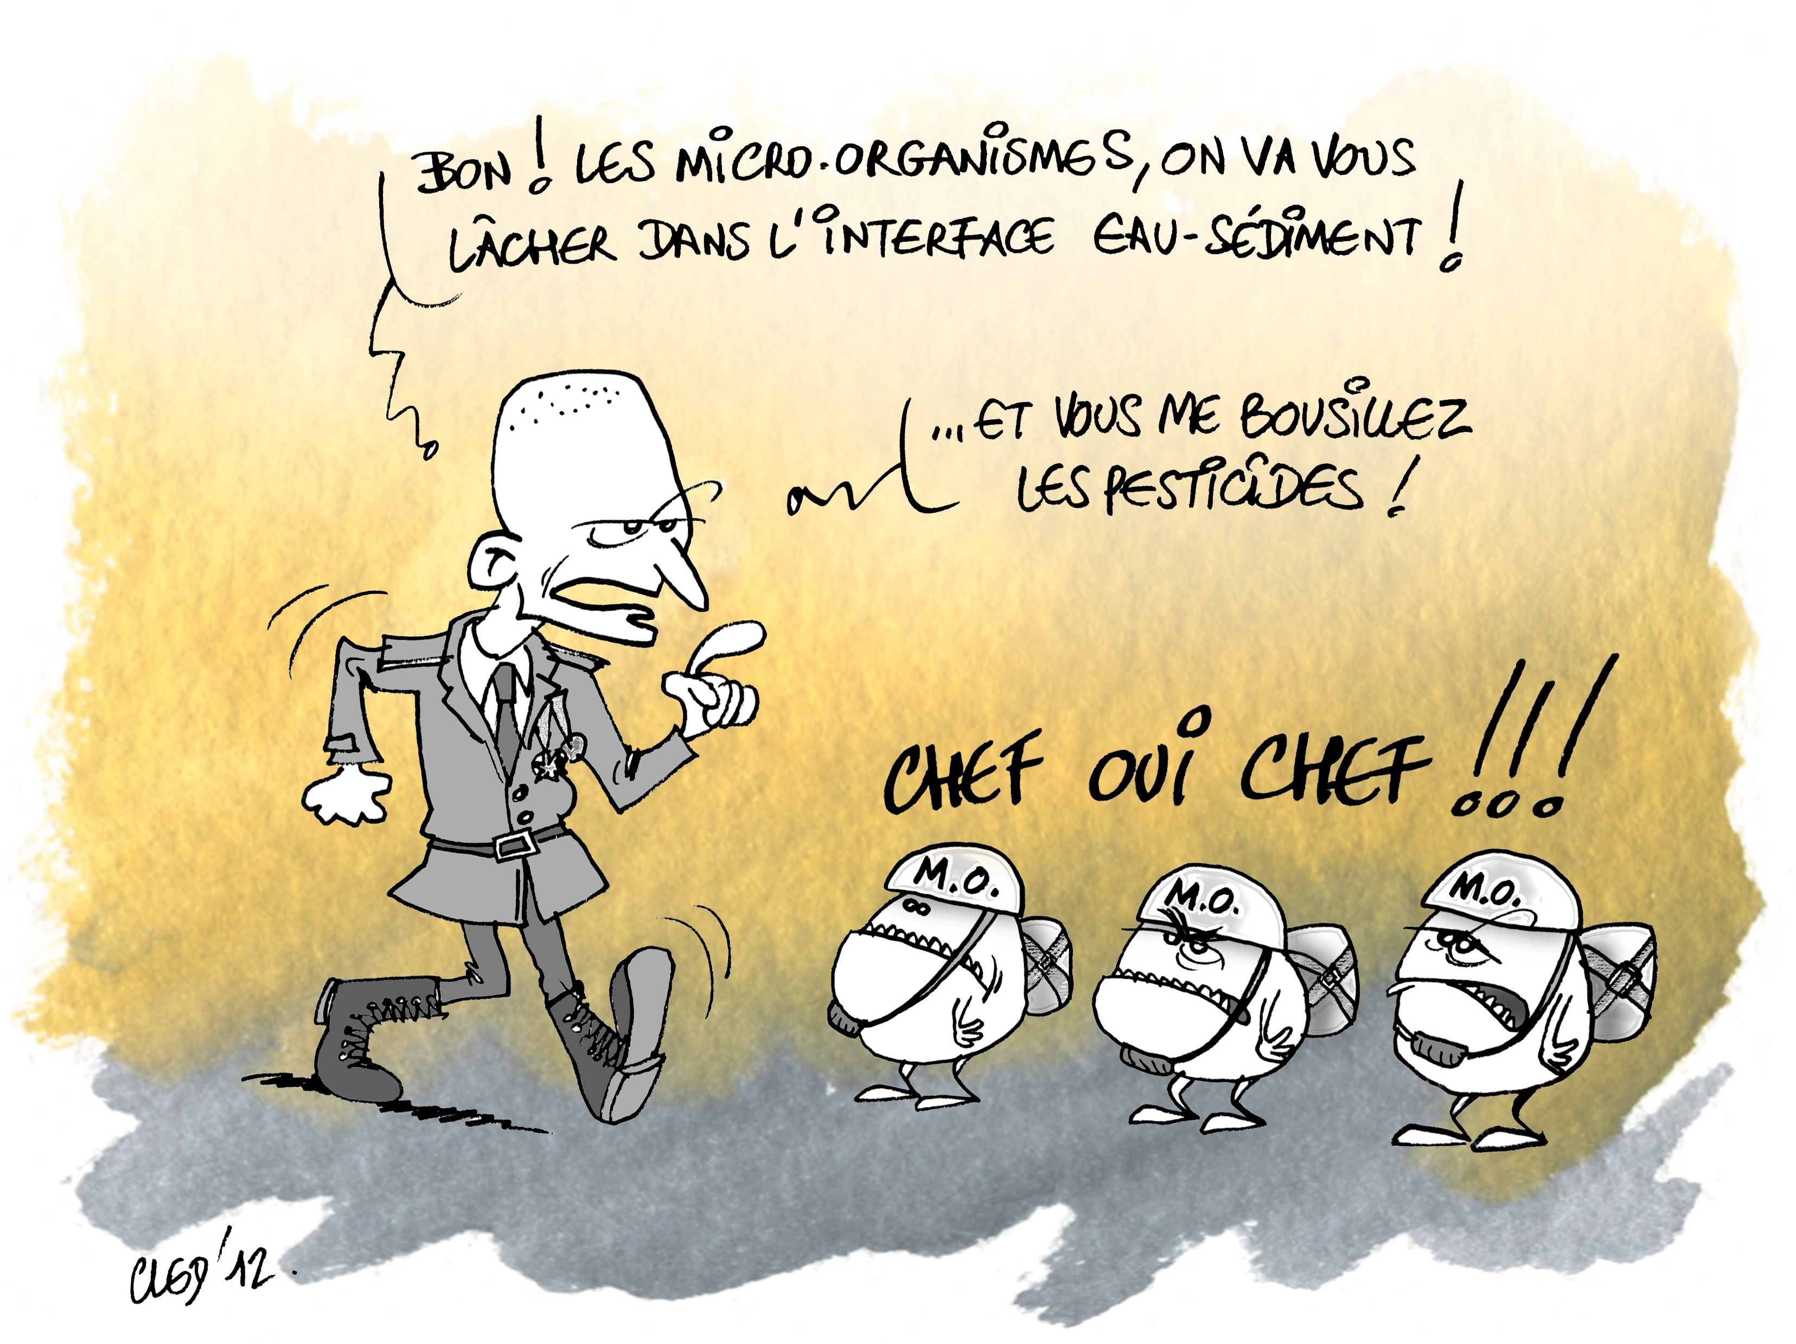
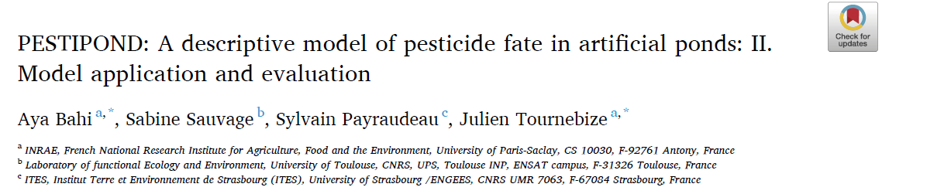
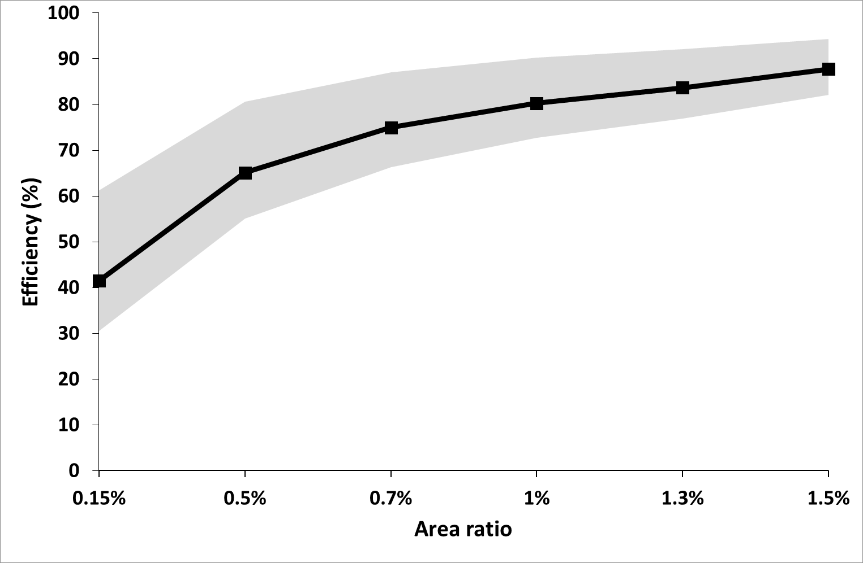
0D lumped conceptual model
Upscaling – Design recommandation
with PESTIPOND model in drainage context
Bahi et al., 2023 –
Part I doi.org/10.1016/j.ecolmodel.2023.110472 – Part II doi.org/10.1016/j.ecolmodel.2023.110453

Slide 18
Framework of PESTIPOND Project
Imfeld et al., 2021 doi.org/10.3390/w13091202

Slide 19
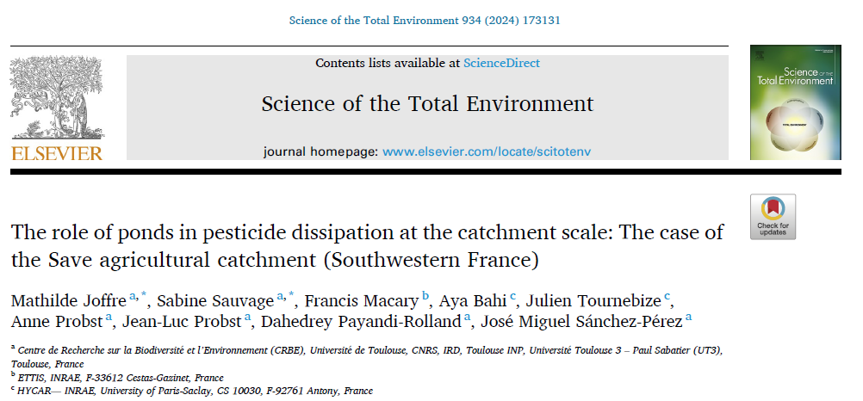

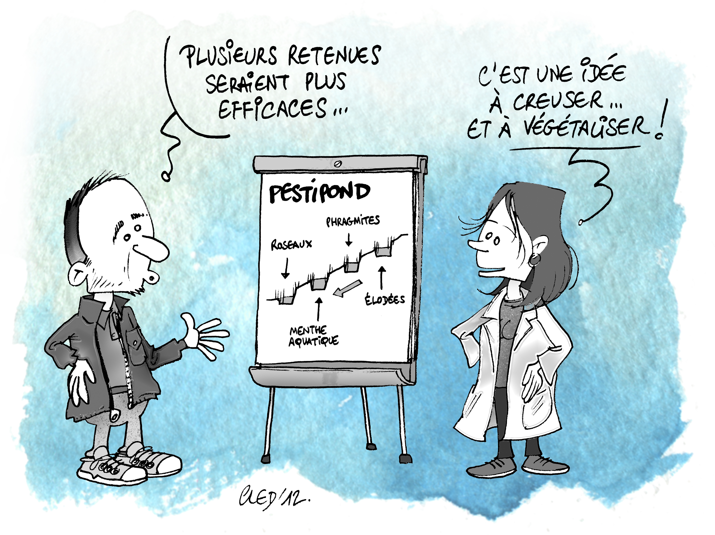
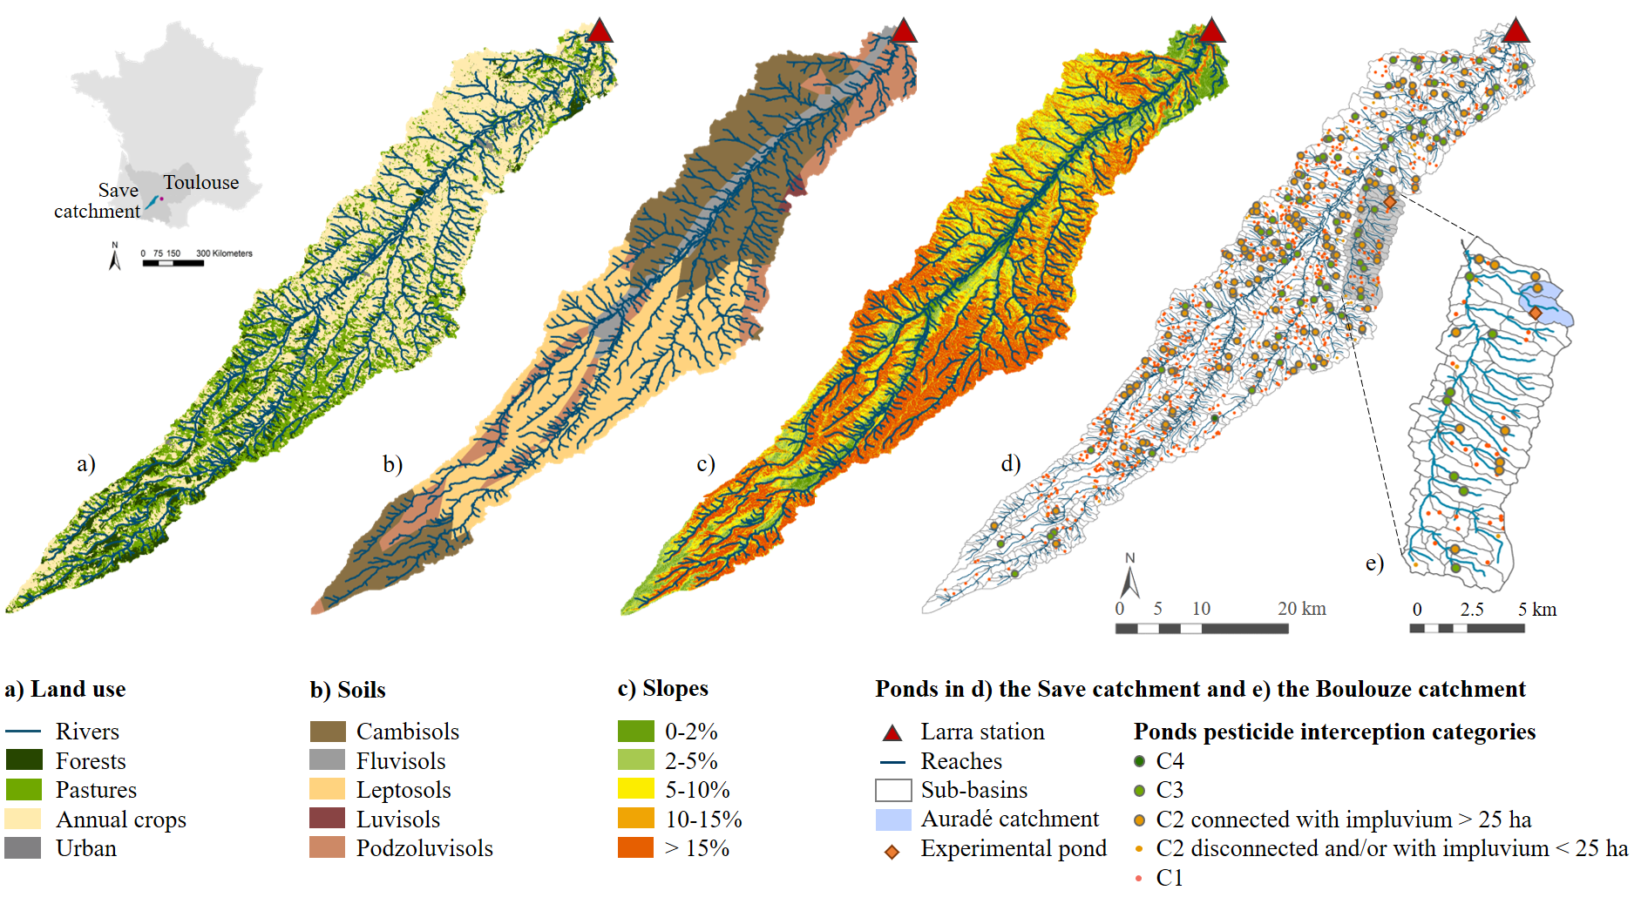
Modelling connectivity of catchment - pond
1) Selection of ponds with high pesticide interception capacity
→ MCDA analysis for classification (Ci) based on:
- pond volume
- impluvium area
- connectivity of the pond
- soil type
- impluvium slope
2) SWAT model of the Save catchment including these ponds
Joffre et al. (2024 https://doi.org/10.1016/j.scitotenv.2024.173131)

Slide 20
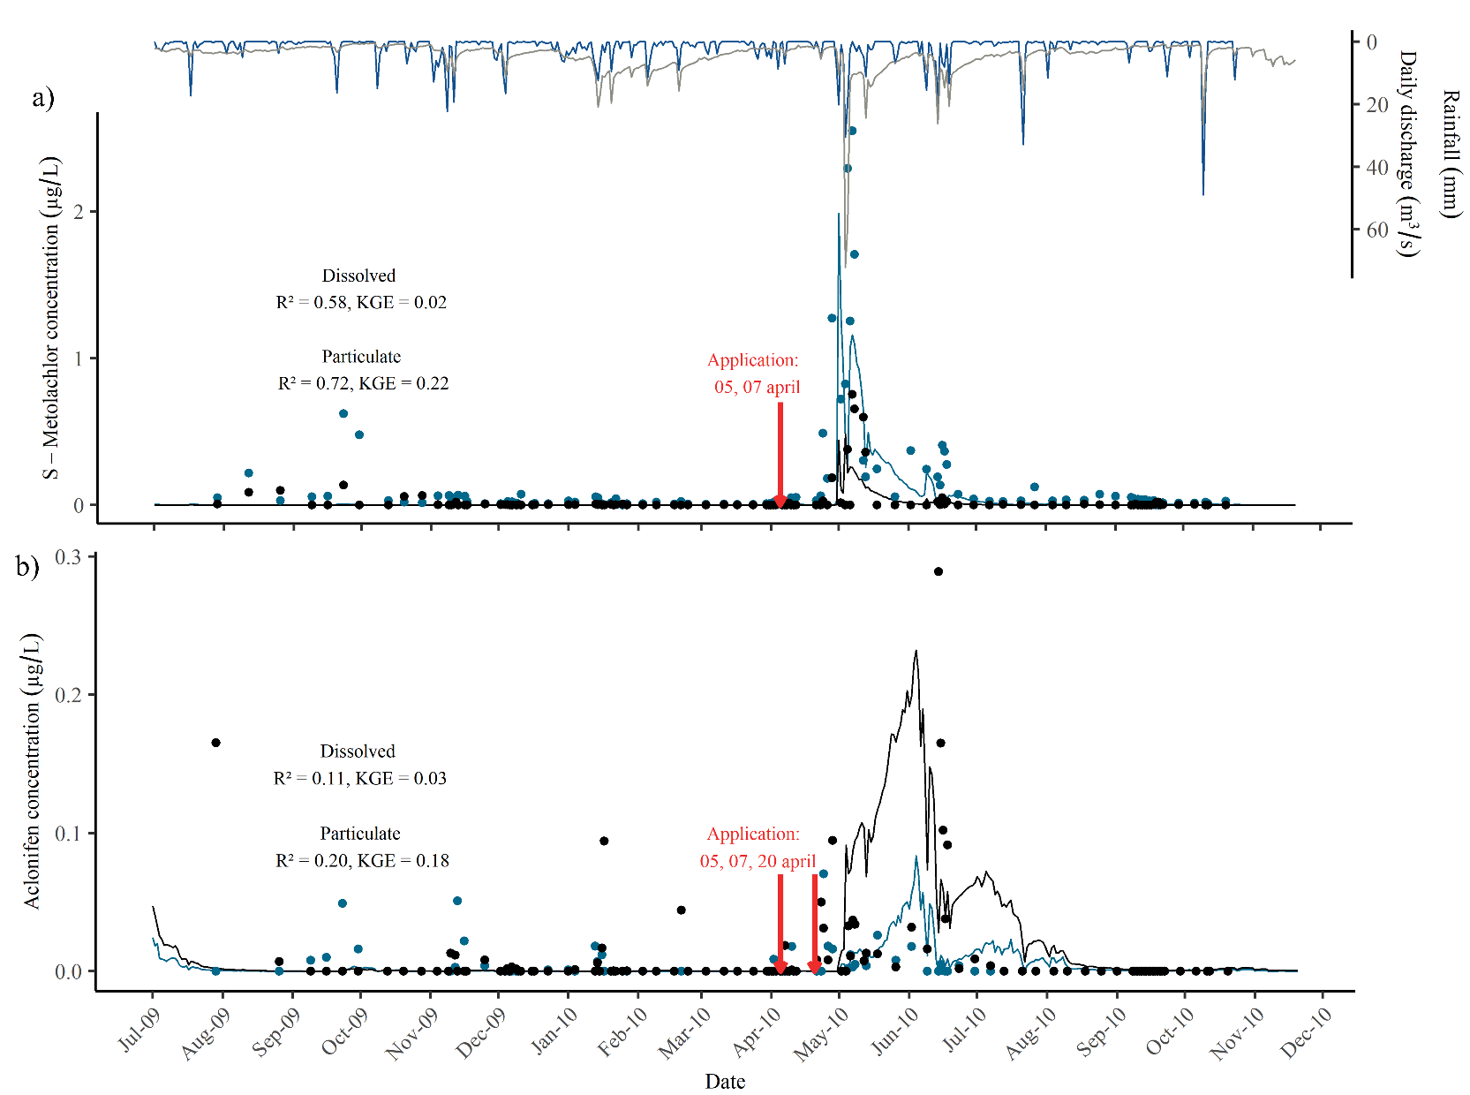



Modelling connectivity of catchment - pond
Joffre et al. (2024)
1083 ponds in the Save Basin,
197 connected ponds included in the model
Calibration of the flow, suspended sediment and herbicides (aclonifen and S-metolachlor in both dissolved and particulate phases) at the catchment outlet
S-metolachlor
Pre-emergence herbicides:
S-metolachlor
Sw=480 mg/L, log(Kow)=2,9
Aclonifen
Sw=1,4 mg/L, log(Kow)=4,37
1.5 kg/ha
0.5 kg/ha
2.7 kg/ha
Application
05, 07, 20 April
Aclonifen
Input data :
Climate (SAFRAN-Météo France)
Land Use and rotations (INRAE)
Soil (FAO)
Discharge (CACG)
SSC and pesticides (Aguaflash project, PYGAR ZA)

Slide 21
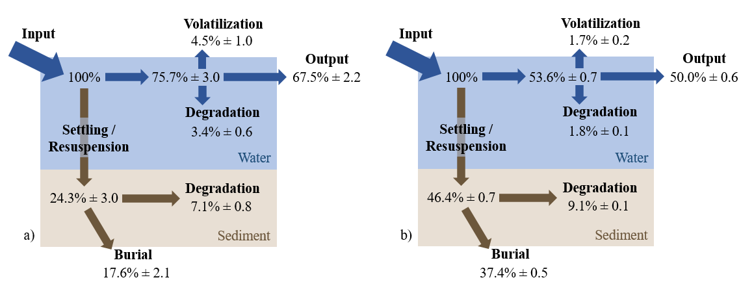
Modelling connectivity of catchment – pond: cumulative impact
Joffre et al. (2024)
Aclonifen
Average cumulative pond dissipation efficiency: 50.0% ± 0.6
Cumulative impact = ponds in serie and addition of efficiency relative to pond / catchment ratio
Brought to the ponds volume → dissipation of 10 g.m⁻³.yr⁻¹ for aclonifen and 3.1 g.m⁻³.yr⁻¹ for s-metolachlor
Dissipation processes mostly sediment-related
Major processes = burial and degradation in the sediment layer
S-Métolachlore
Average cumulative pond dissipation efficiency: 32.5% ± 2.2
NOT A WARRANTY of 100% removal!
Proportions are expressed as a function of pesticide amounts entering into the ponds

Slide 22
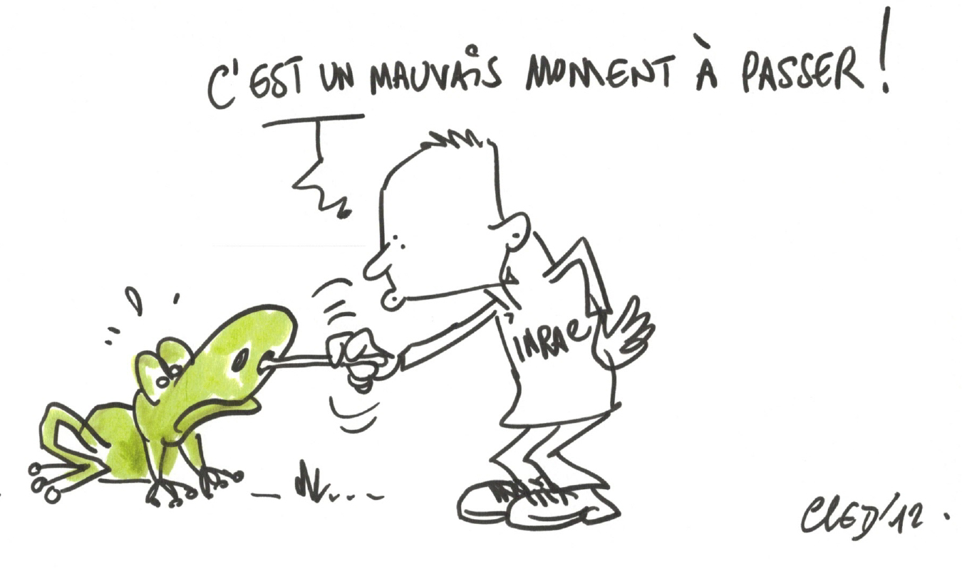

PESTIPOND
Ponds are efficient to dissipate pesticides but not eliminate them
Importance of particulate phase and substrate interface
Ponds trap more pesticides than degradate them completely
Ponds play the role of buffering pesticide pollution
Metabolites will be the next issue
Biodiversity exposition as well: Synbiotox project
Ecological trajectory
Thèse A. Michel 2025

Slide 23
PESTIPOND publications
- Bahi, A., Sauvage, S., Payraudeau, S. and Tournebize, J. (2023) PESTIPOND: A descriptive model of pesticide fate in artificial ponds: I. Model development. Ecological Modelling 485, 110453.
- Bahi, A., Sauvage, S., Payraudeau, S. and Tournebize, J. (2023) PESTIPOND: A descriptive model of pesticide fate in artificial ponds: II. Model application and evaluation. Ecological Modelling 484, 110472.
- Bahi A., Sauvage S., Payraudeau S., Imfeld G., Sánchez-Pérez J-M., Chaumet B., Tournebize J. (2023). Process formulations and controlling factors of pesticide dissipation in artificial ponds: A critical review. Ecological Engineering 186, 106820. https://doi.org/10.1016/j.ecoleng.2022.106820
- Gilevska T., Masbou J., Baumelin B., Chaumet B., Chaumont C., Payraudeau S., Tounebize J., Probst A., Probst J.-L., Imfeld G. (2022). Do pesticides degrade in surface water receiving runoff from agricultural catchments? Combining passive samplers (POCIS) and compound-specific isotope analysis. Science of the Total Environmen, 156735.
- Imfeld G., Payraudeau S., Tournebize J., Sauvage S., Macary F., Chaumont C., Probst A., Sanchez-Pérez J-M., Bahi A., Chaumet B., Gilevska T., Alexandre H., Probst J-L. (2021). The Role of Ponds in Pesticide Dissipation at the Agricultural Catchment Scale: A Critical Review. Water 13 (9), 1202. https://doi.org/10.3390/w13091202
- Joffre M., Sauvage S., Macary F., Bahi A., Tournebize J., Probst A., Payandi-Rolland D., Sanchez-Pérez J-M (2023) The role of ponds in pesticide dissipation at the catchment scale: the case of the Save agricultural catchment (Southwestern France). https://doi.org/10.1016/j.scitotenv.2024.173131
- Chaumet B., Probst J.L., Eon P., Camboulive T., Riboul D., Payre-Suc V., Granouillac F., Probst A. (2021). Role of pond sediments for trapping pesticides in an agricultural catchment (Auradé, SW France): distribution and controlling factors. Water, 13, 1734. https://doi.org/10.3390/w13131734
- Chaumet B., Probst J.L., Payre-Suc V., Granouillac F., Riboul D., Probst A. (2022). Pond mitigation in dissolved and particulate pesticide transfers: influence of storm events and seasonality (Auradé agricultural catchment, SW-France). J. of Environmental Management, 320, 115911, https://doi.org/10.1016/j.jenvman.2022.115911
- Chaumet B., Probst J.L., Eon P., Payre-Suc V., Granouillac F., Camboulive T., Riboul D., Pautot C., Tavella M.J., Trochon B., Probst A. (2022). Pesticide distribution in pond sediments from an agricultural catchment (Auradé, SW France). Environ. Sci. Proc., 3, x. https://doi.org/10.3390/xxxxx
- Drouin G., Droz B., Leresche F., Payraudeau S., Masbou J., Imfeld G. (2021). Direct and indirect photodegradation of atrazine and S-metolachlor in agriculturally impacted surface water and associated C and N isotope fractionation. Environmental Science: Processes & Impacts. 23 (11), 1791-1802.
- Droz B., Drouin G., Maurer L., Villette C., Payraudeau S. Imfeld G. (2021). Phase Transfer and Biodegradation of Pesticides in Water-Sediment Systems Explored by Compound-Specific Isotope Analysis and Conceptual Modeling. Environmental Science & Technology. doi.org/10.1021/acs.est.0c06283
Gilevska T., Payraudeau S., Imfeld G. (2023). Evaluating pesticide degradation in artificial wetlands with compound-specific isotope analysis: A case study with the fungicide dimethomorph. Science of the Total Environment. 165767. https://doi.org/10.1016/j.scitotenv.2023.165767
Chaumet, B., Riboul, D., Probst, JL. et al. Seasonal Influence on Pesticide Transfer and Bioaccumulation in Native Wetland Vegetation in an Agricultural Critical Zone. Environmental Management 75, 1139–1154 (2025). https://doi.org/10.1007/s00267-025-02135-z

Slide 24
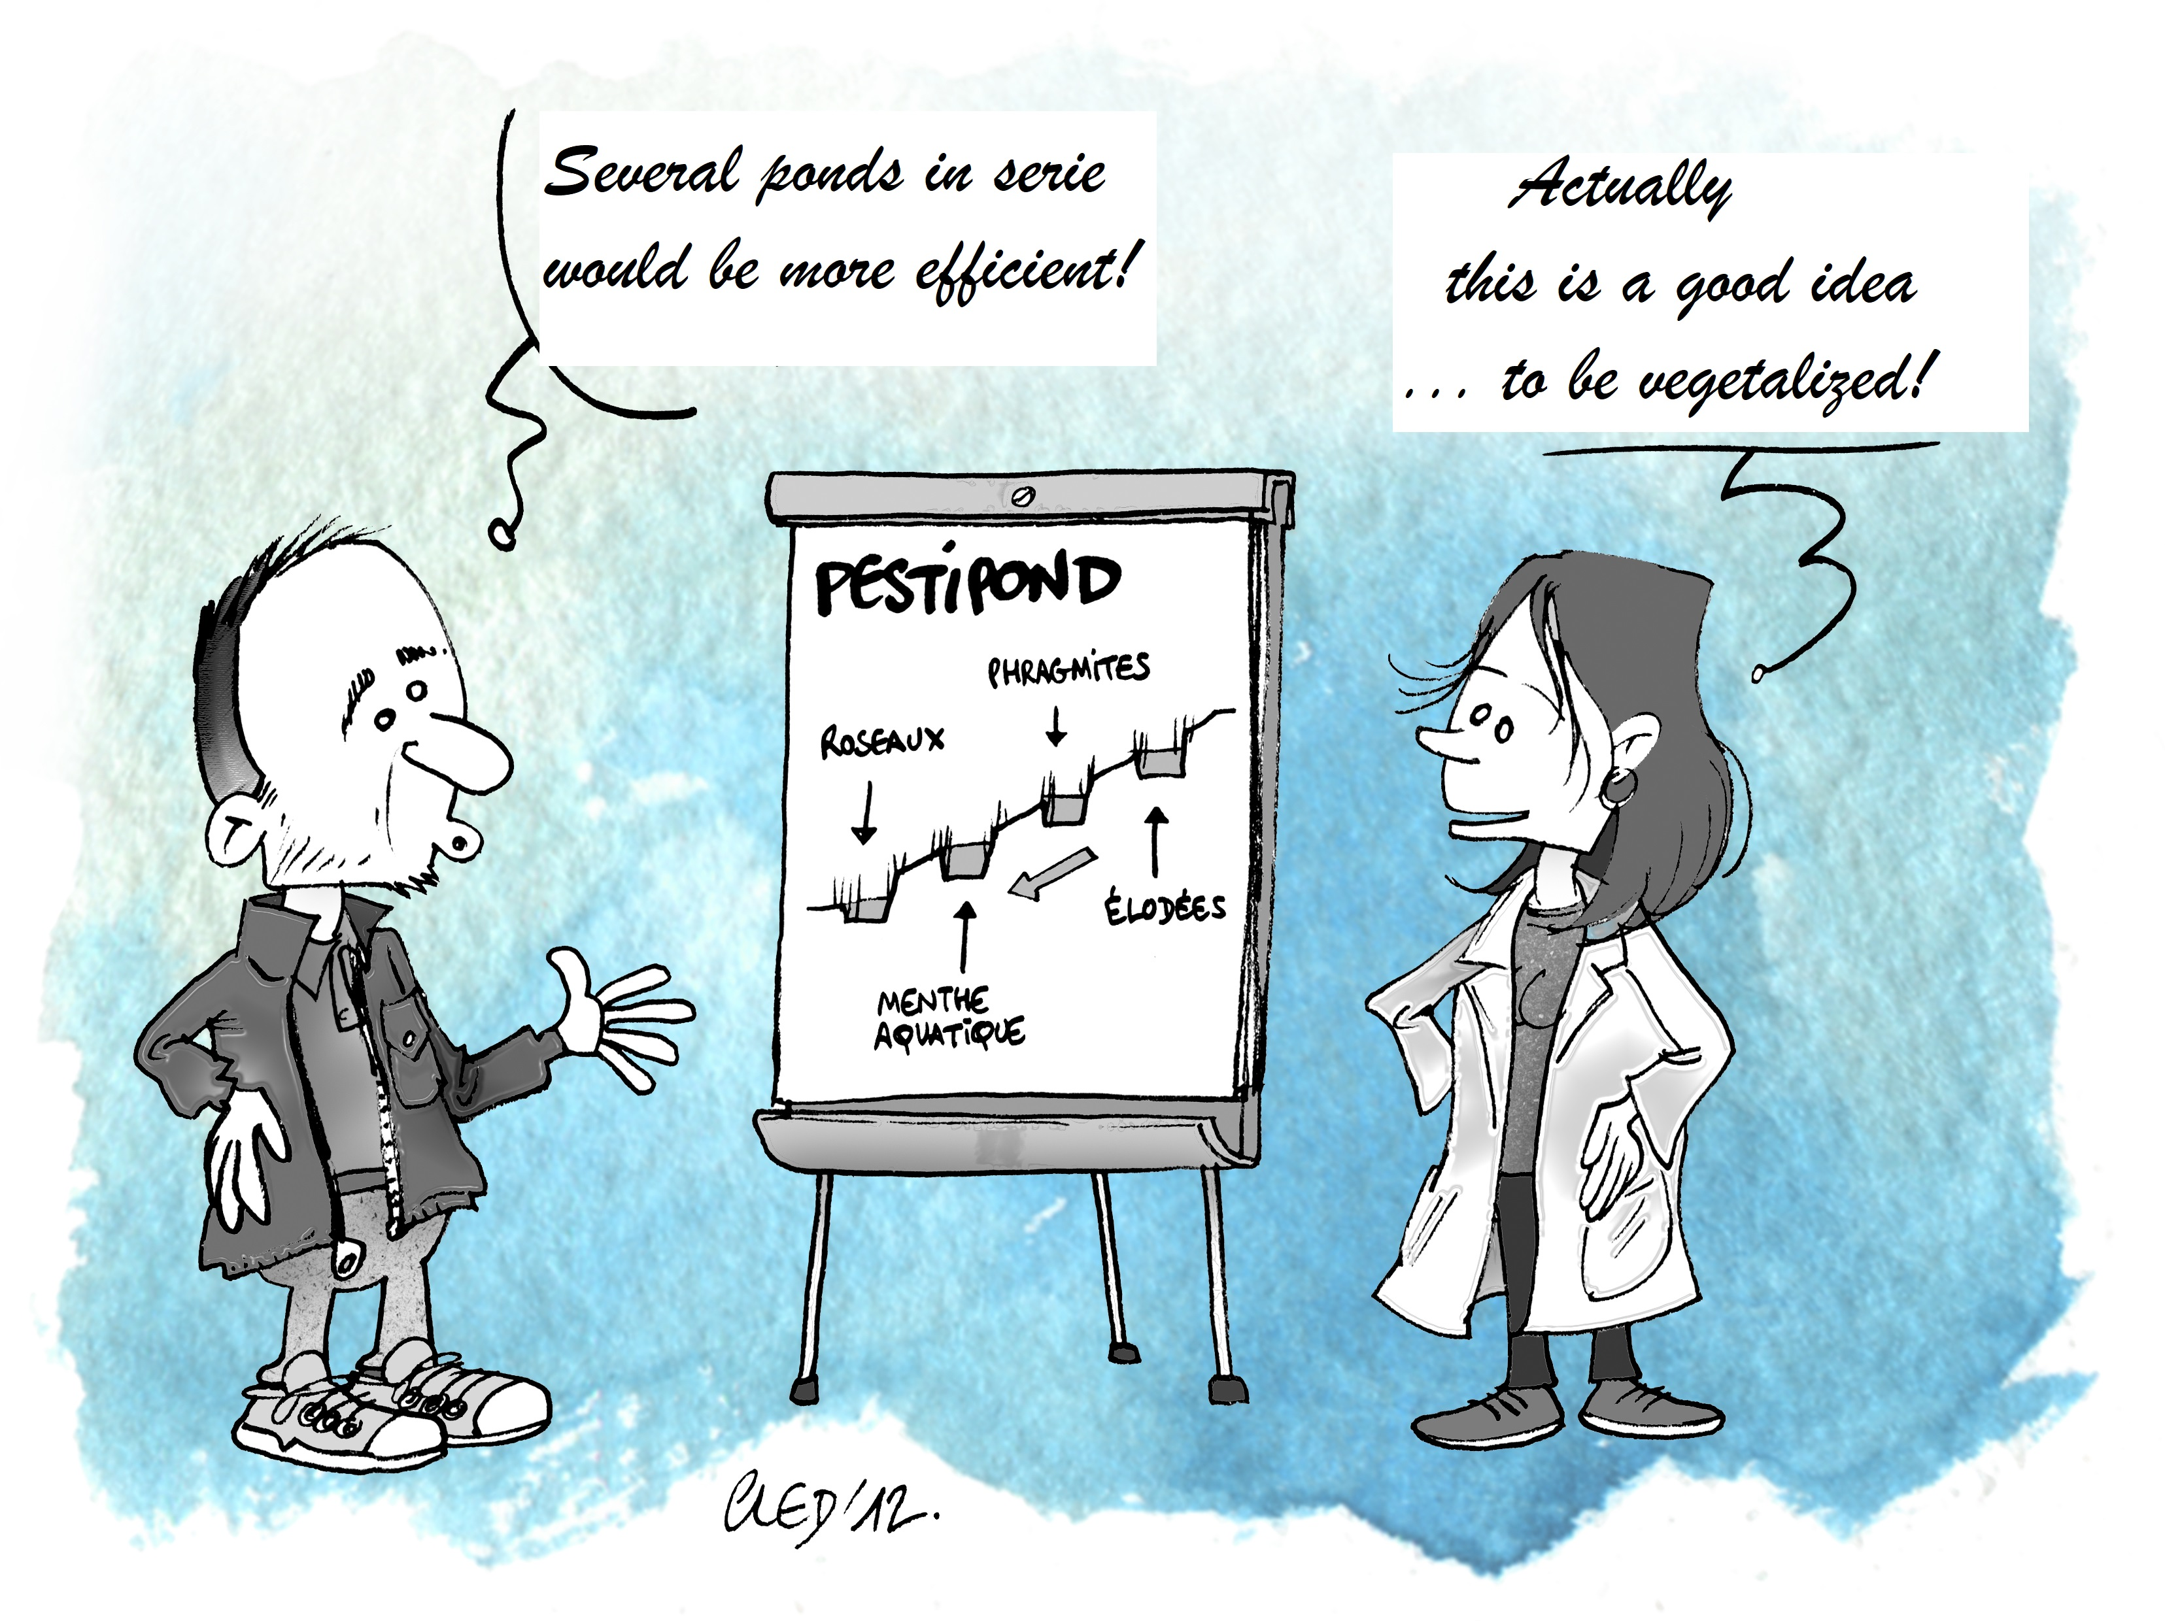

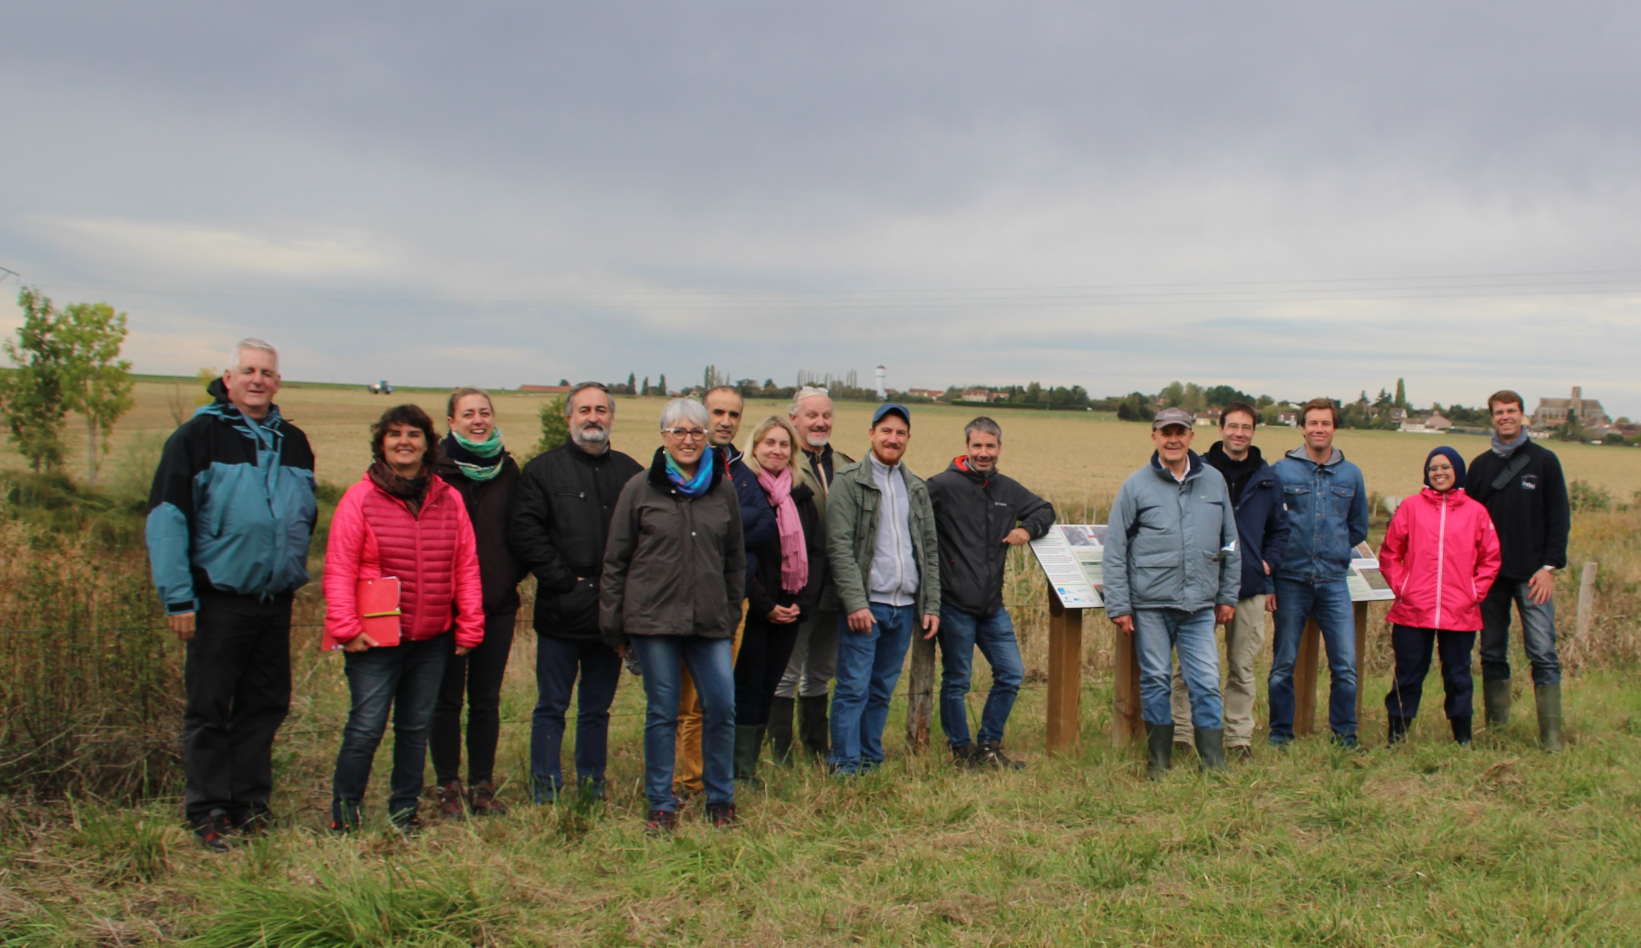
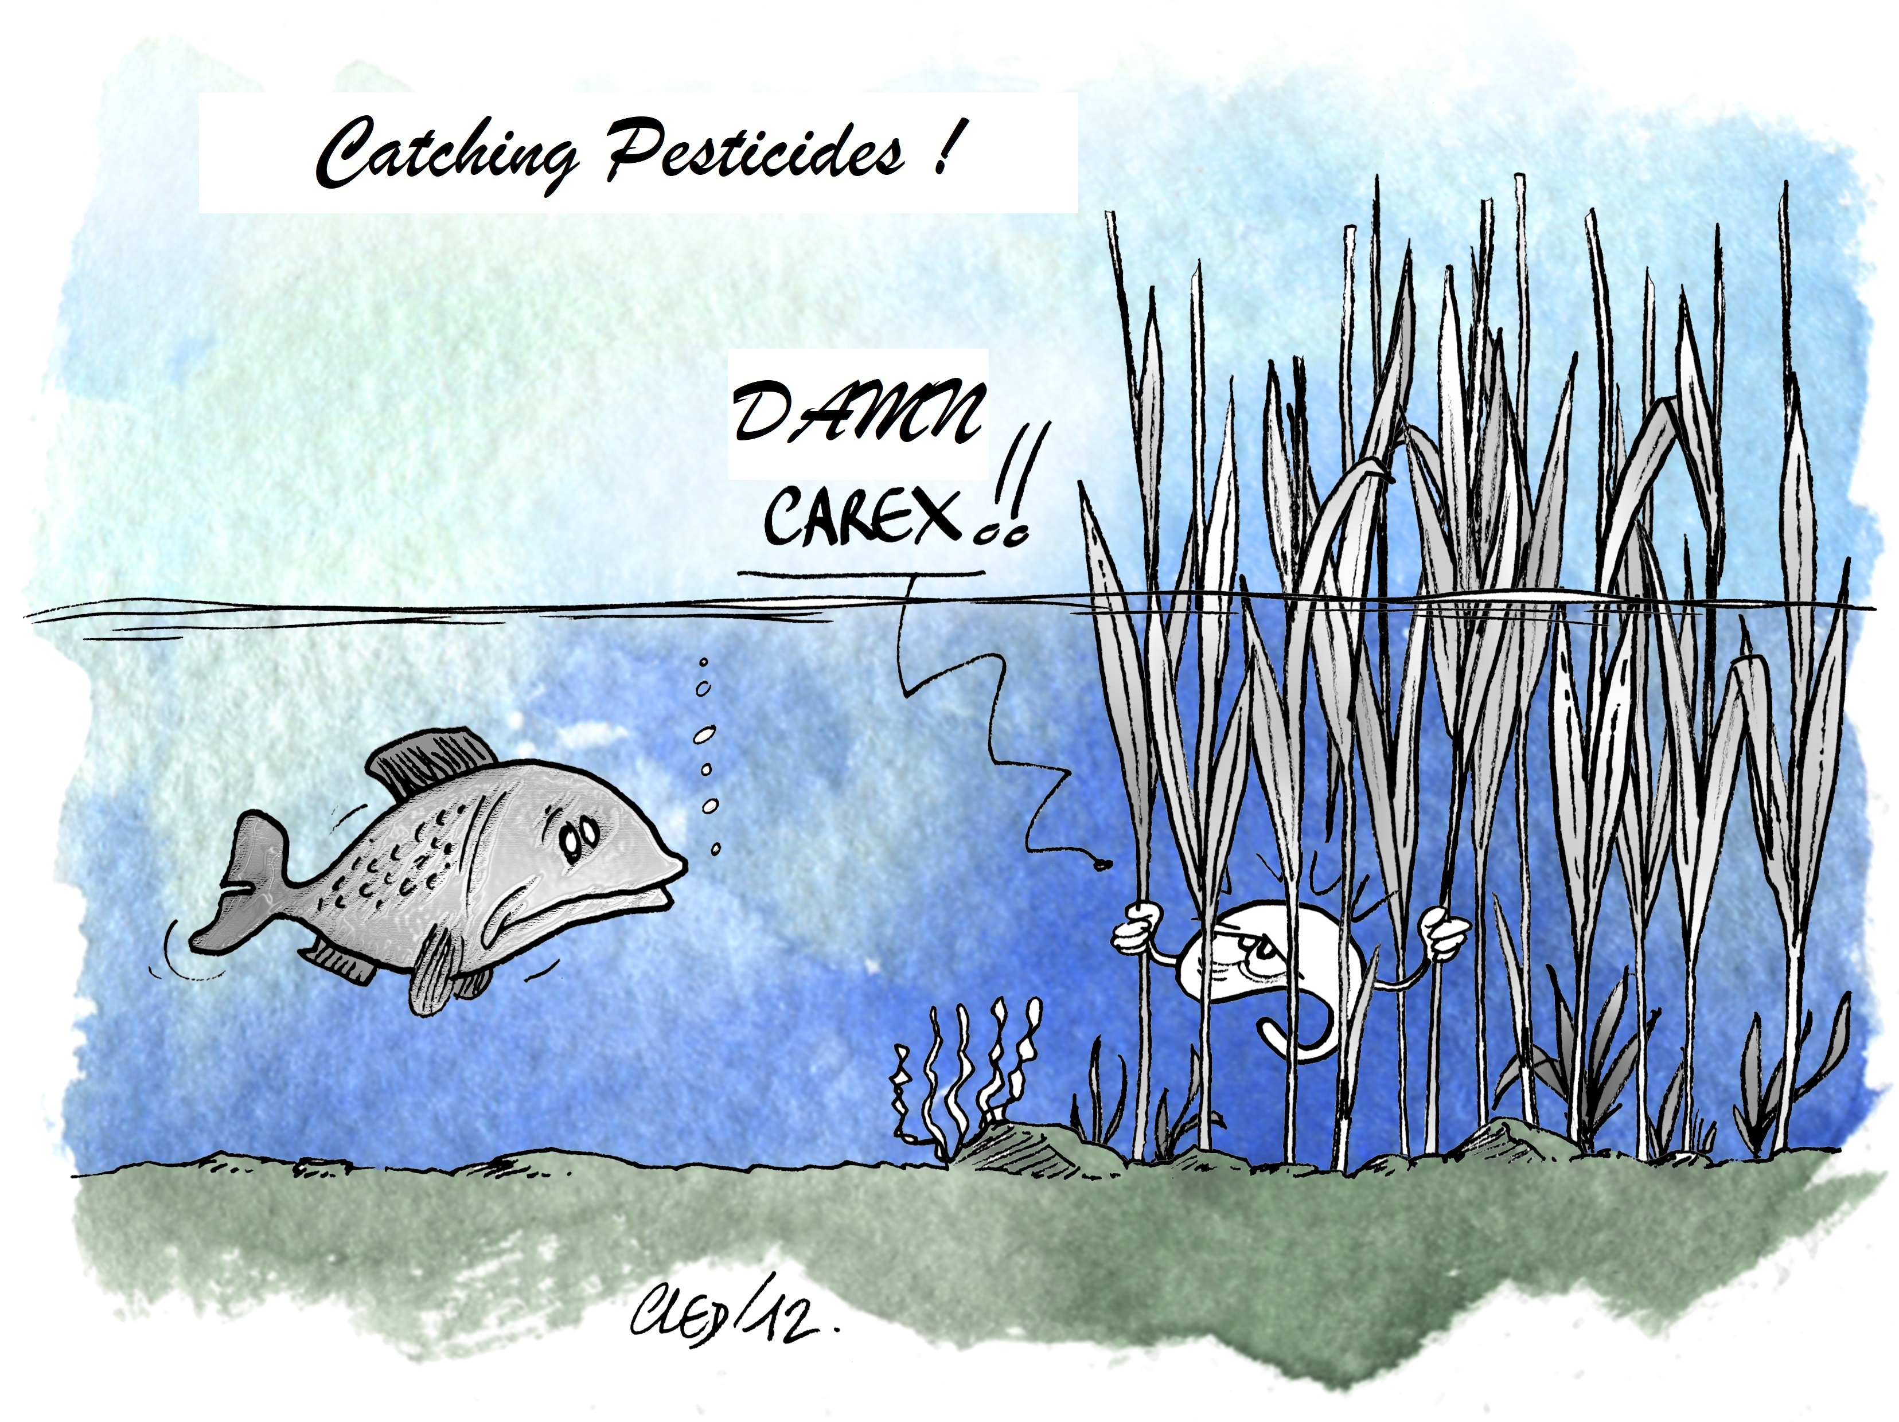
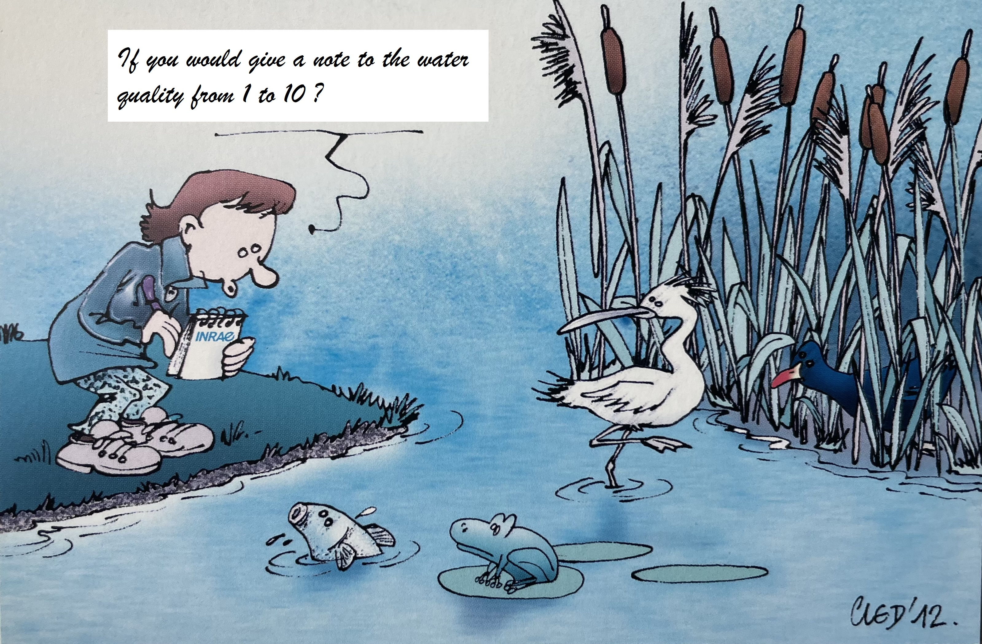

THANK YOU FOR YOUR ATTENTION
Great « PESTIPOND » team
Funded by ANR

